Slide 1

High Performance Computing Using GPUs
Mehrzad Samadi
mehrzad@parabricks.com

Slide 2
Thank You
CMSC 828E: Seminar on Scientific Computing on Graphical Processors
CUDA Programming Guide
The Modern GPU: A Graphic History (HPC Wire)

Slide 3
Why GPUs?

Slide 4
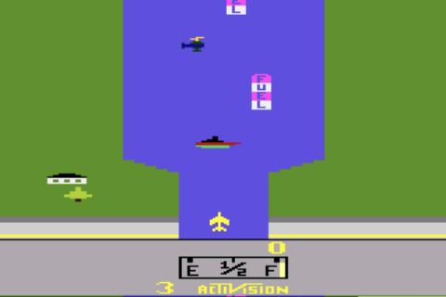
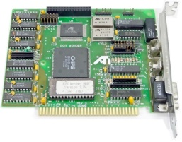
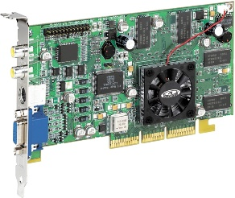
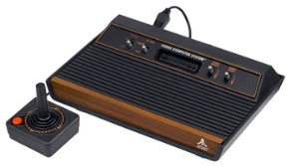
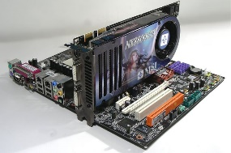
History of GPUs
ATI was bought out by AMD $5.4 billion
ATI EGA 800: 16-color VGA
First ATI Radeon
Atari 2600
First NVIDIA Product
NVIDIA GTX 8800
Introducing CUDA
1977
1987
1995
2000
2006
2007

Slide 5
Peak Performance
21 billion transistors
Performance equivalent to 100 CPUs
Volta
Pascal
Maxwell
Kepler

Slide 6
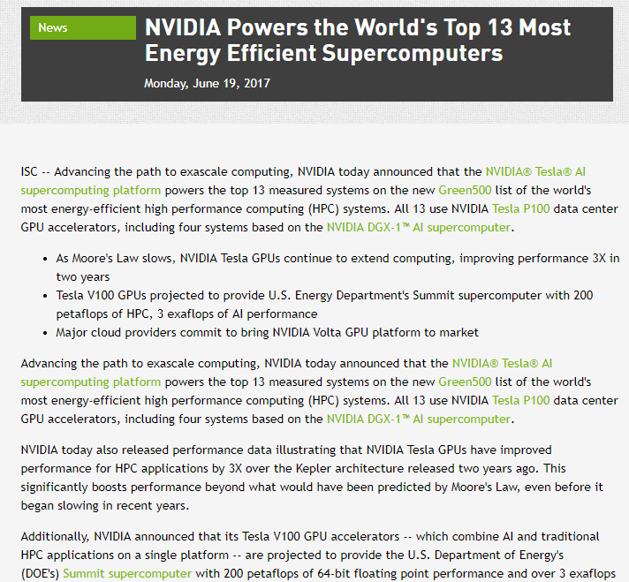
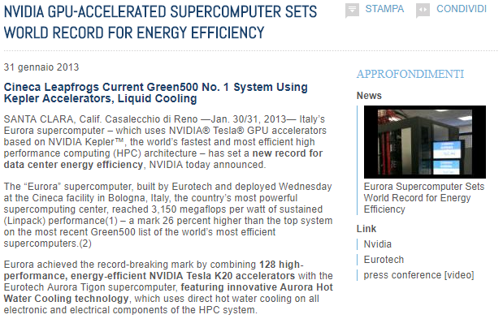
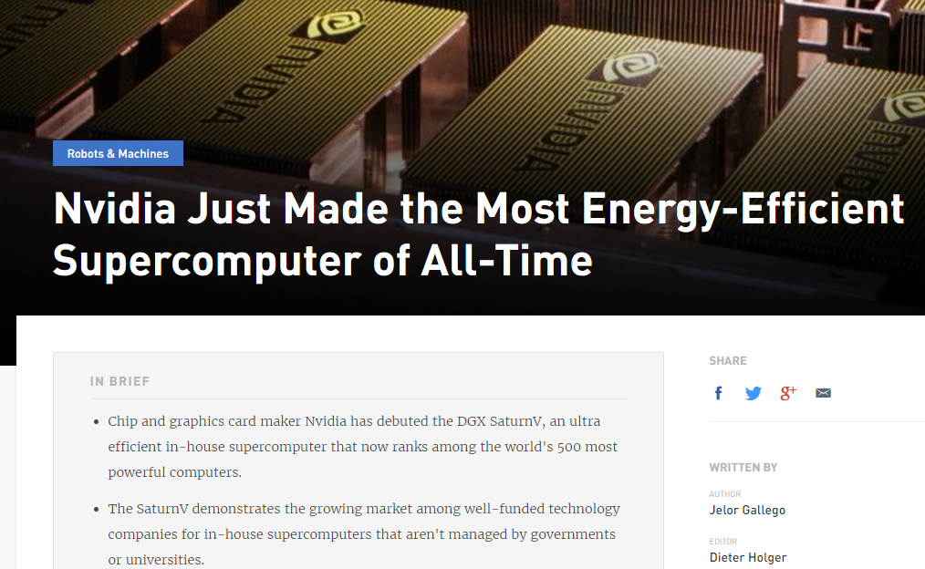
All top 13 use GPUs (Green500)

Slide 7
Using GPUs

Slide 8
Applications

Slide 9
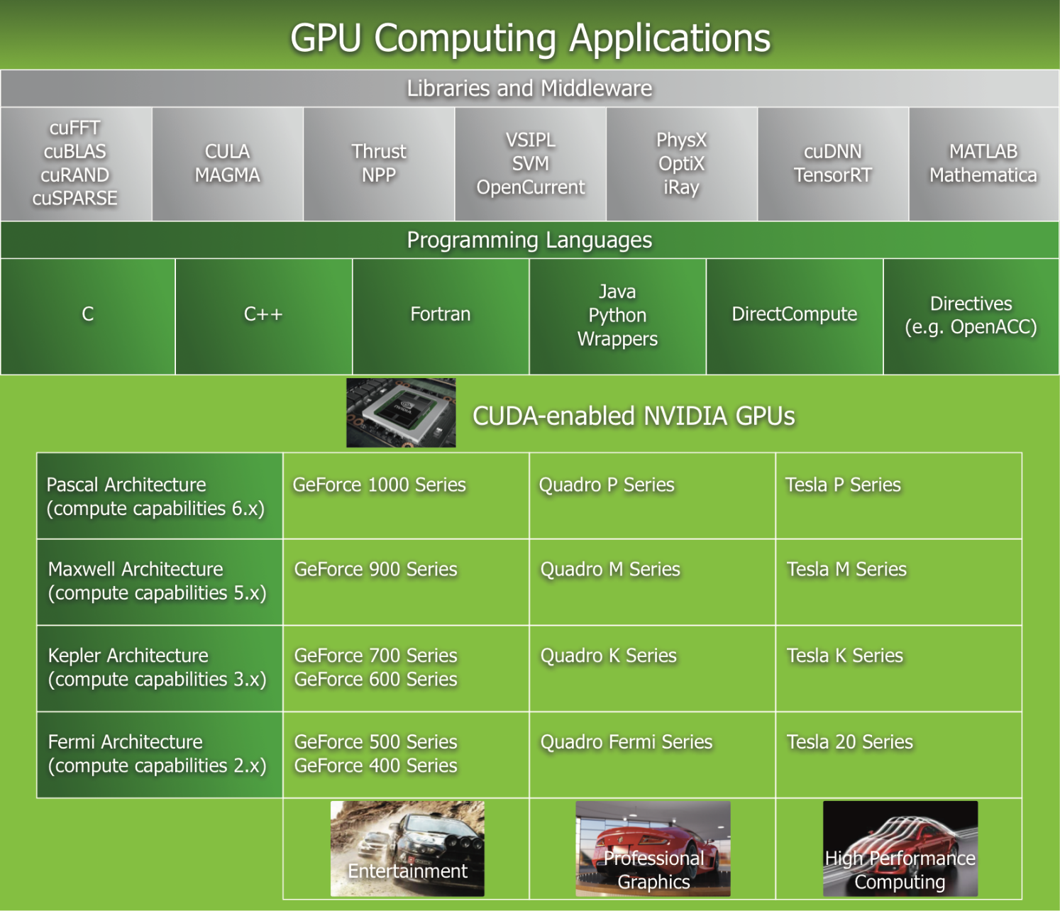
GPU Computing Applications

Slide 10
Ways to use GPUs
GPU-ready application
Machine Learning (Caffe, Theano, …)
Matlab, R, Python
http://www.nvidia.com/object/gpu-applications.html
NVIDIA Libraries
cuDNN, CUBLAS, cuFFT, cuSparse, CULA
https://developer.nvidia.com/gpu-accelerated-libraries
Directives: OpenACC/ OpenMP
Languages: CUDA/OpenCL

Slide 11
Vector Add
OpenACC
// sum component wise and save result into vector c
#pragma acc kernels copyin(a[0:n],b[0:n]), copyout(c[0:n])
for(i=0; i<n; i++) {
c[i] = a[i] + b[i];
}
CUDA
__global__ vectorAdd(int * a, int * b, int *c, int n){
int tid = blockIdx.x * blockDim.x + threadIdx.x;
if (tid < n)
c[tid] = a[tid] + b[tid];
}

Slide 12
Getting Performance is Hard

Slide 13
Architecture

Slide 14
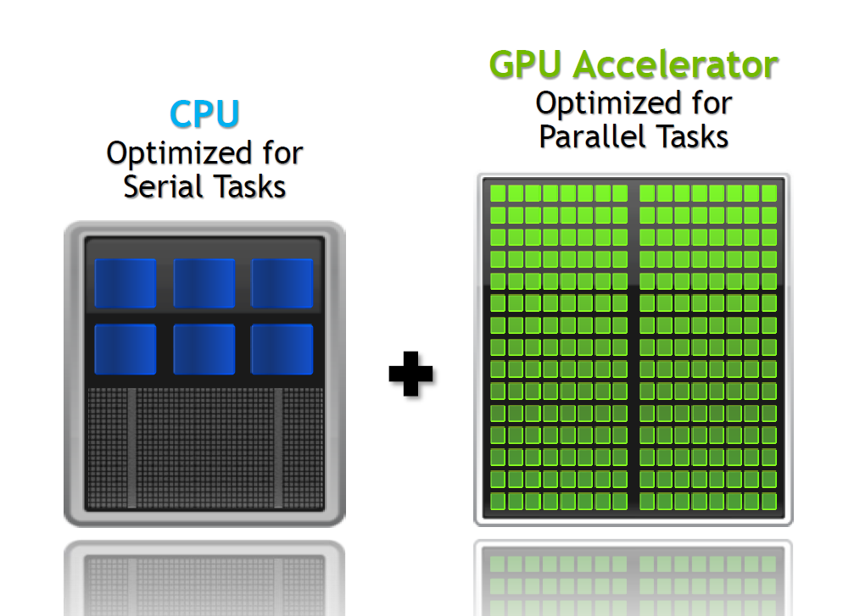
Accelerated Computing

Slide 15
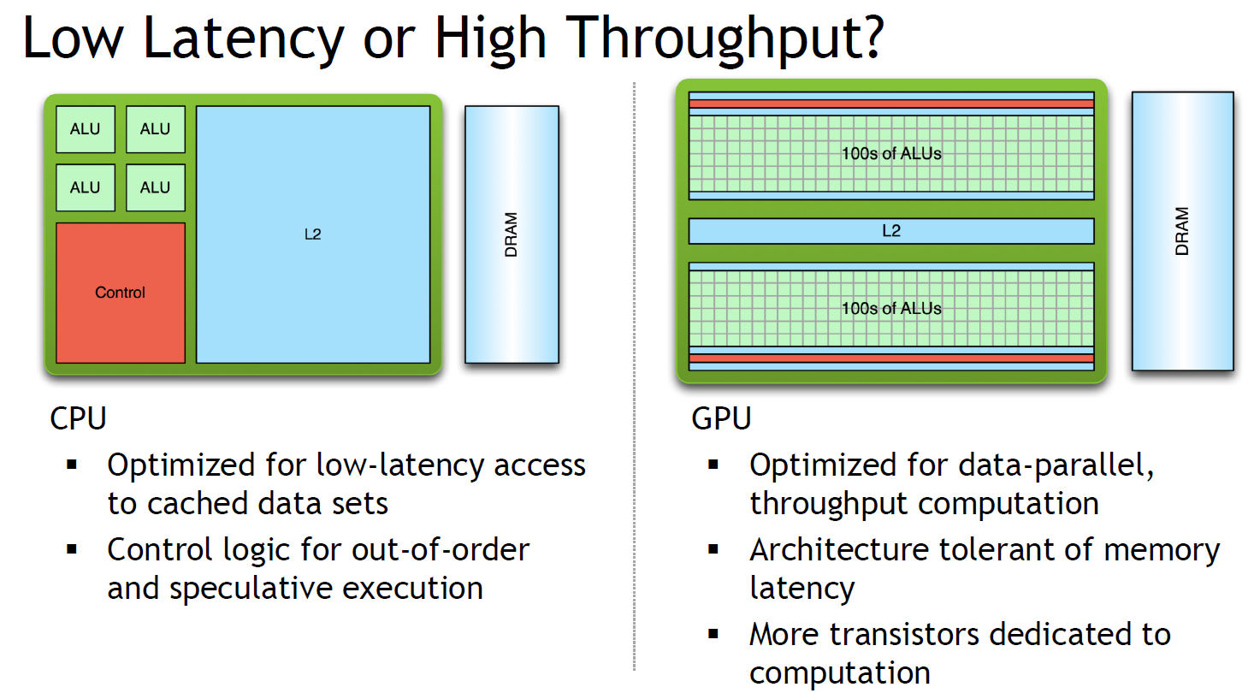
Accelerated Computing

Slide 16
Latency/ Throughput

Slide 17
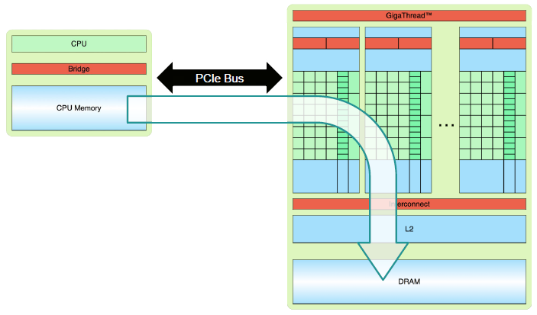
CPU + GPU Communication

Slide 18
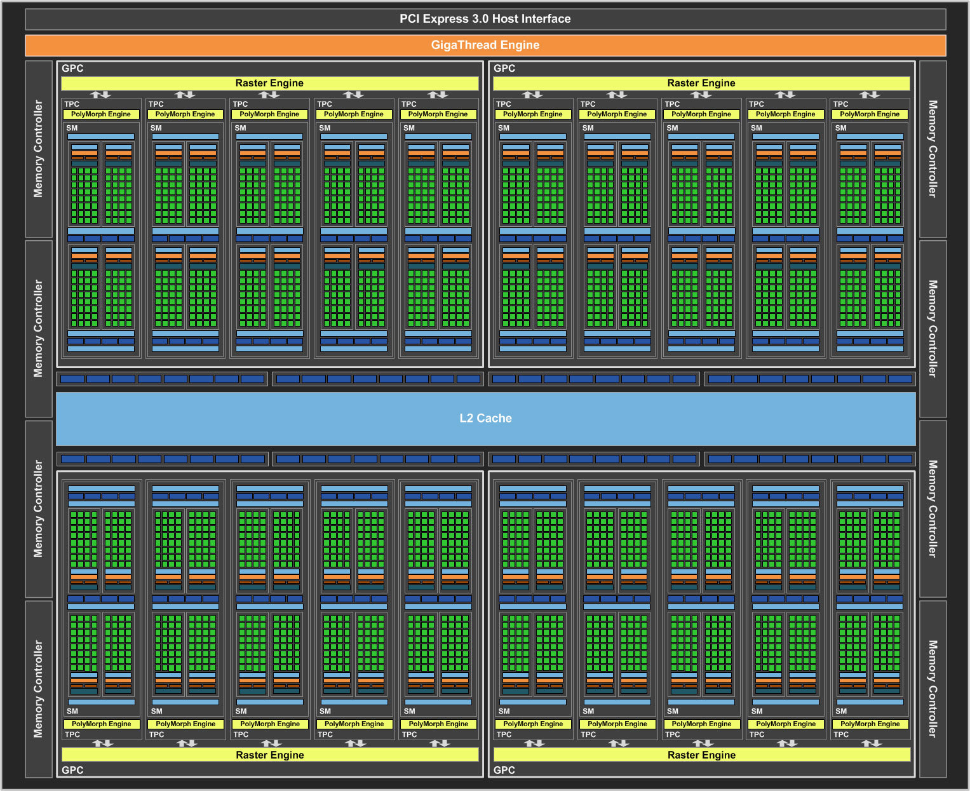
GPU Architecture
GTX 1080 (Pascal)
2560 CUDA cores
Boost Clock: 1733 MHz
Memory BW: 320 GB/sec
7.2 billion
20 SMs

Slide 19
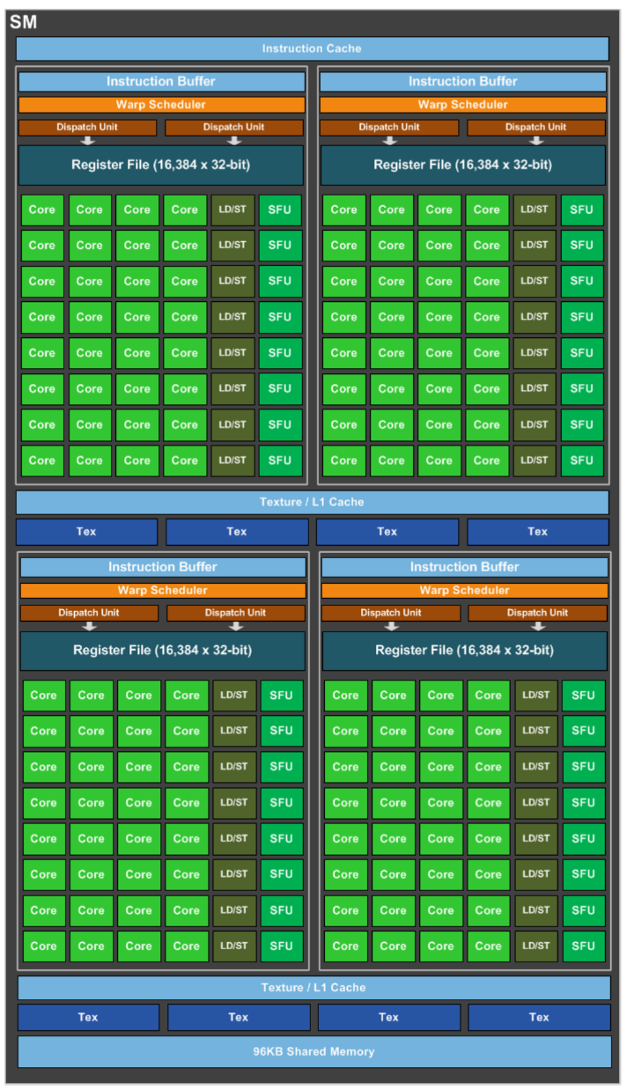
Streaming Multiprocessor
Each SM:
128 CUDA cores
256 KB of register file capacity
96 KB shared memory unit
48 KB of total L1 cache storage

Slide 20
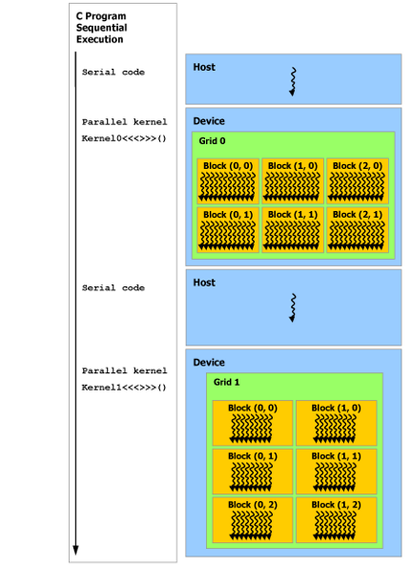
Execution

Slide 21
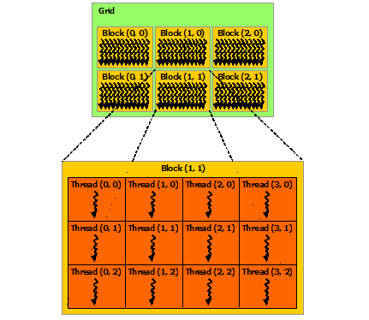
Threads
Cude_kernel<<<6,12>>>(a,b,c, n);

Slide 22
ThreadID

Slide 23
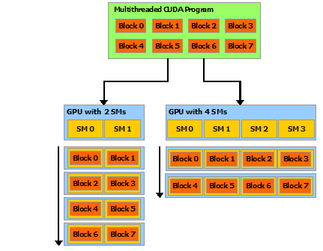
Kernel Launch

Slide 24
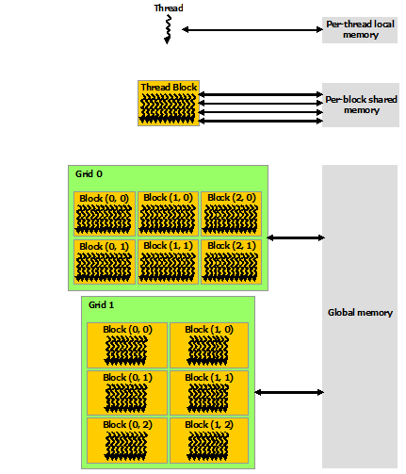
Memory Hierarchy

Slide 25
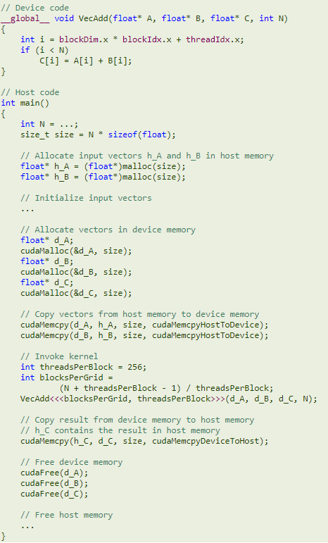
Vector Add
Allocate Memory
Transfer Input
Run
Transfer Output
Free

Slide 26
Matrix Multiplication

Slide 27
1. Matrix Multiplication (Host Version)

Slide 28
2. Transfer Data

Slide 29
3. Output Transfer

Slide 30
4. Kernel Function

Slide 31
5. Host-Side Code

Slide 32
First Version

Slide 33
Tile

Slide 34
Tile

Slide 35
Shared Memory

Slide 36
Shared Memory

Slide 37
Syncthread

Slide 38
Shared Memory

Slide 39
Performance Tuning

Slide 40
Occupancy
Limitation:
Shared Memory Size
Register Usage
Number of threads

Slide 41
Memory Coalescing
Coalesced
Non-Coalesced

Slide 42
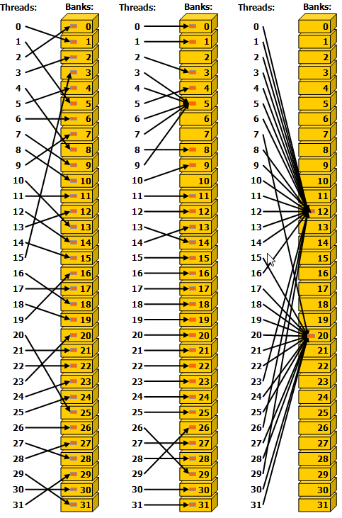
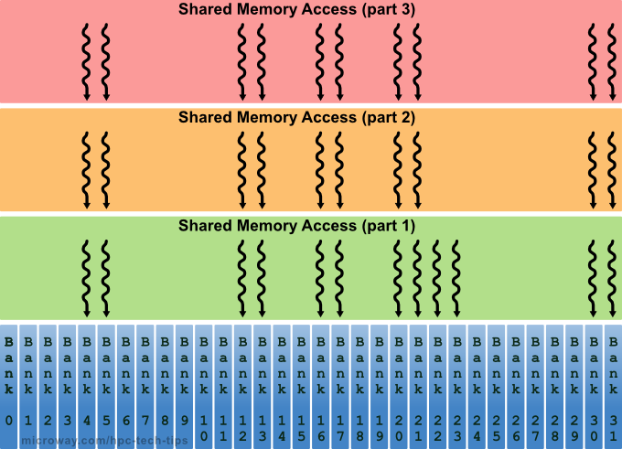
Shared Memory Bank Conflict
32 banks (4 bytes each)

Slide 43
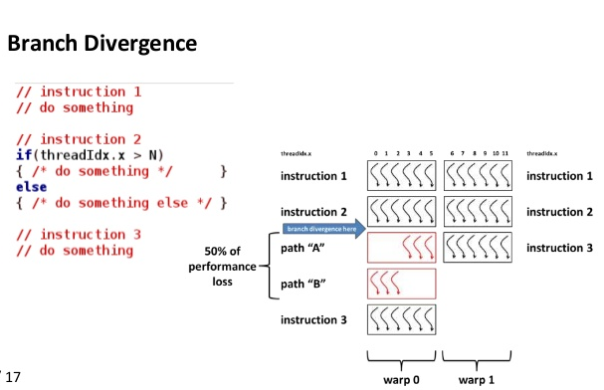
Divergence

Slide 44
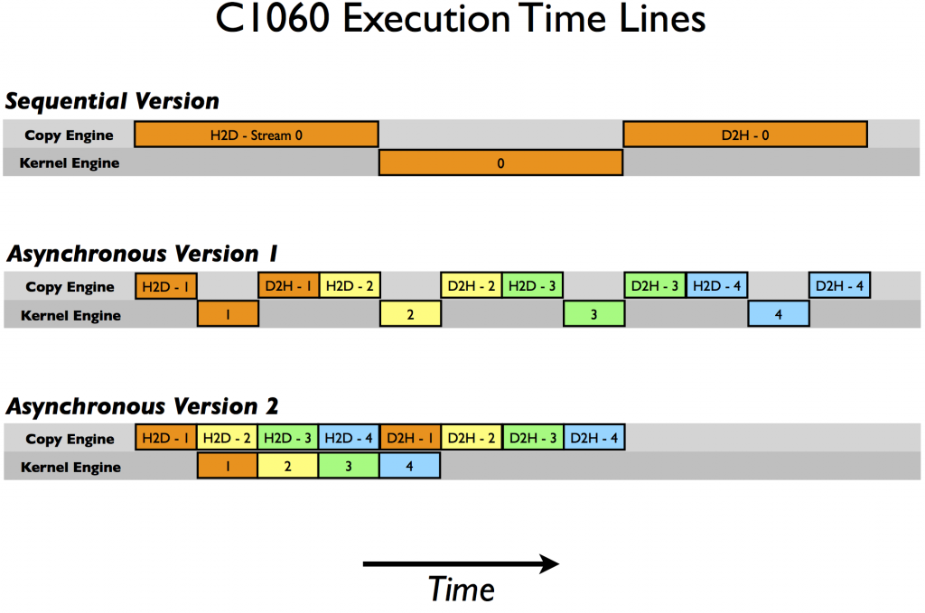
Streaming

Slide 45
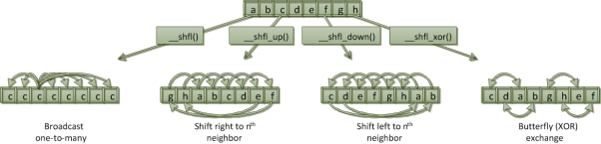
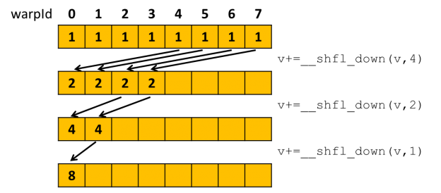
Intra-warp Communication

Slide 46
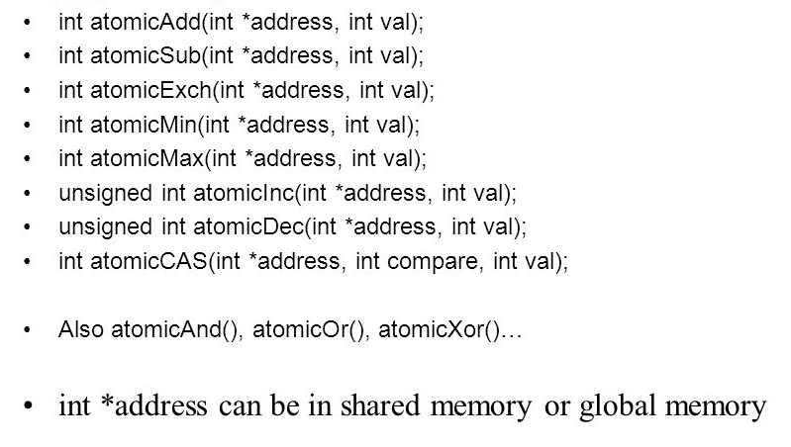
Atomic Operations

Slide 47
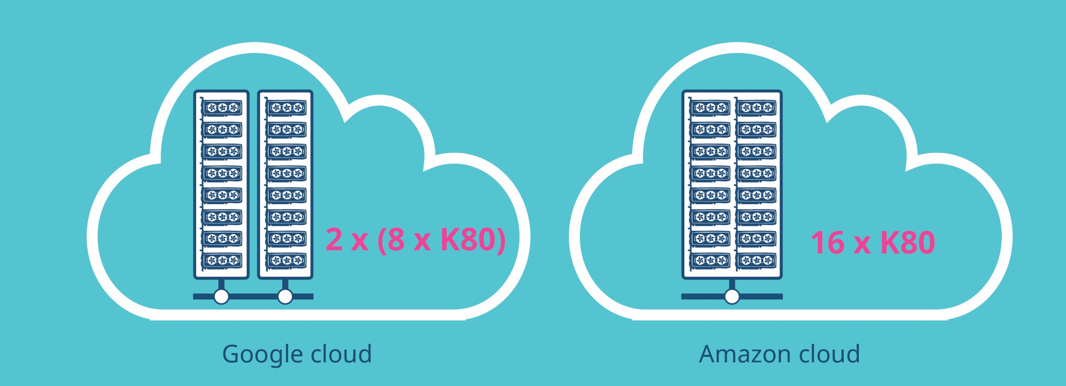
Cloud

